Slide 1
ssShortcutsss

Slide 2

Multiply or Divide by 2 (without arithmetic operator)

Slide 3
Multiply or Divide by 2 (No Condition)
int n = 7;
int mul = n << 1; // multiply by 2
int div = n >> 1; // divide by 2

Slide 4
Positive or Negative

Slide 5
Positive or Negative
(MSB Trick)
Concept:
Leftmost bit in integer = sign bit.
positive → sign bit = 0
negative → sign bit = 1
int n = -10;
int sign = (n >> 31) & 1;
String[] ans = {"Positive", "Negative"};
System.out.println(ans[sign]);

Slide 6

Even or Odd

Slide 7
Even or Odd (LSB Trick)
Concept:
Even → last bit = 0
Odd → last bit = 1
int n = 7;
String[] ans = {"Even", "Odd"};
System.out.println(ans[n & 1]);

Slide 8
Absolute Value (No Condition)

Slide 9
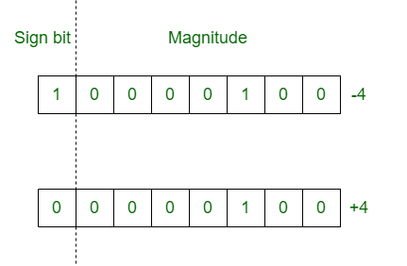

Slide 10
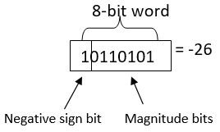
Absolute Value (No Condition)
Why before comparing?
Because greater/smaller uses method similar to abs logic.
int n = -12;
int mask = n >> 31;
int absValue = (n + mask) ^ mask;
System.out.println(absValue);

Slide 11
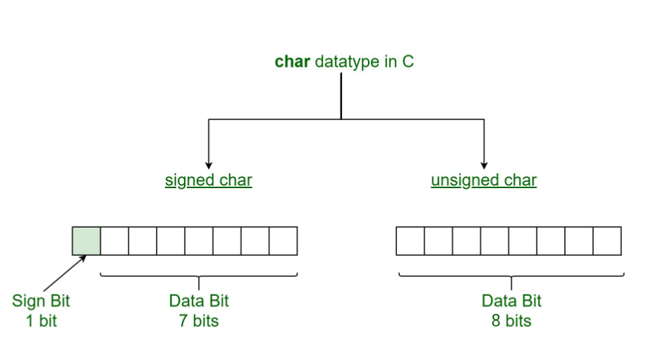

Slide 12
Max / Min of 2 Numbers (No Condition)

Slide 13
Max / Min of 2 Numbers (No Condition)
int a = 30, b = 50;
int diff = a - b;
int k = (diff >> 31) & 1; // 0 → a>=b, 1 → b>a
int[] bigger = {a, b};
int[] smaller = {b, a};
System.out.println("Greater: " + bigger[k]);
System.out.println("Smaller: " + smaller[k]);

Slide 14

Max of 3 Numbers

Slide 15
Max of 3 Numbers (Reusing Max of 2)
int a = 10, b = 20, c = 5;
int diff1 = a - b;
int k1 = (diff1 >> 31) & 1;
int max1 = new int[]{a, b}[k1];
int diff2 = max1 - c;
int k2 = (diff2 >> 31) & 1;
int max = new int[]{max1, c}[k2];
System.out.println("Max = " + max);

Slide 16

Swap Two Variables
b = a + b - (a = b);

Slide 17
Swap Two Variables (XOR Trick)
int a = 5, b = 10;
a = a ^ b;
b = a ^ b;
a = a ^ b;

Slide 18
Uppercase → Lowercase

Slide 19
Uppercase → Lowercase (OR 32)
char c = 'H';
char lower = (char)(c | 32);
System.out.println(lower);

Slide 20
Lowercase → Uppercase

Slide 21
Lowercase → Uppercase (AND 95)
char c = 'h';
char upper = (char)(c & 95);
System.out.println(upper);

Slide 22

Toggle Case

Slide 23
STEP 7 — Toggle Case (XOR 32)
char c = 'a';
char toggled = (char)(c ^ 32);
System.out.println(toggled);

Slide 24

Check Alphabet (NO CONDITIONS)

Slide 25
Check Alphabet (NO CONDITIONS)
Convert to lowercase
char c = 'G’;
char lower = (char)(c | 32);
int isAlpha = ((lower - 'a') | ('z' - lower)) >> 31 & 1;
String[] ans = {"Alphabet", "Not Alphabet"};
System.out.println(ans[isAlpha]);
→ check if range a–z using bit logic.

Slide 26
Check Two Numbers Equal (NO Condition)

Slide 27
Check Two Numbers Equal (NO Condition)
If a ^ b = 0, then a and b are equal.
int a = 10, b = 10;
String[] ans = {"Equal", "Not Equal"};
int eq = (a ^ b);
System.out.println(ans[eq == 0 ? 0 : 1]); // want pure no-cond? I'll give arr trick

Slide 28
Check Power of Two (No Condition)

Slide 29
Check Power of Two (No Condition)
int n = 16;
int x = n & (n - 1);
String[] ans = {"Power of 2", "Not Power of 2"};
System.out.println(ans[x]);
n & (n - 1) == 0 → power of 2

Slide 30

Find Unique Element in Array

Slide 31
Find Unique Element in Array (XOR)
(When every element repeats twice except one.)
int[] arr = {4, 5, 4, 8, 5};
int x = 0;
for(int n : arr)
x ^= n;
System.out.println(x);

Slide 32

Smallest of 2 Numbers

Slide 33
Smallest of 2 Numbers (Same logic as max)
int a = 10, b = 20;
int diff = a - b;
int k = (diff >> 31) & 1;
System.out.println(new int[]{b, a}[k]); // smallest

Slide 34

Check multiple of 4 (no condition)

Slide 35
Check multiple of 4 (no condition)
boolean isMultipleOf4 = (n & 3) == 0;
Trick: For any number divisible by 4, last two bits are 00

Slide 36

Check if two numbers have the SAME sign

Slide 37
Check if two numbers have the SAME sign
boolean sameSign = (((a ^ b) >> 31) & 1) == 0;
If signs are same → XOR MSB = 0

Slide 38

Turn ON a bit at position pos

Slide 39
Turn ON a bit at position pos
num = num | (1 << pos);

Slide 40

Turn OFF a bit at position

Slide 41
Turn OFF a bit at position
num = num & ~(1 << pos);

Slide 42
Toggle a bit at position pos

Slide 43
Toggle a bit at position pos
num = num ^ (1 << pos);

Slide 44

Rotate digits using math
(NO strings, NO inbuilt functions)

Slide 45
Rotate digits using math
Example: Rotate last digit to front
Input → 1234 Output → 4123
int rotateRight(int n) {
int lastDigit = n % 10;
int pow = 1;
int temp = n;
while (temp > 9)
{
pow = pow * 10;
temp = temp / 10;
}
return lastDigit * pow + n / 10;
}

Slide 46
Positive or Negative
Even or Odd
Absolute Value
Max / Min of 2 Numbers
Max of 3 Numbers
Swap Two Variables
Toggle Case.
Uppercase → Lowercase
Lowercase → Uppercase
Check Alphabet
Check Two Numbers Equal
Check Power of Two
Multiply or Divide by 2
Find Unique Element in Array
Smallest of 2 Numbers
Check multiple of 4
Check if two signs are same
Turn ON a bit
Turn OFF a bit
Toggle a bit
Rotate digits using math

